Slide 1
Naukri.com –
Trending Job Market
Analysis 2026
Excel
Power Query
PivotTables
PivotCharts
Start ›

Slide 2





Project Introduction
Project Purpose
01
02
Analyze the Indian IT job market using job-listing data to understand hiring demand, popular roles, locations, skills, experience levels and work arrangements.
Prepare consistent and analysis-ready data
Identify the most demanded job categories and titles
03
04
05
Compare companies by number of listings and ratings
Explore hiring locations and work modes
Understand experience requirements and fresher opportunities

Slide 3




Problem Statement
Raw job listings
The Challenge
Inconsistent titles, companies, locations, experience and skills
Job listings contain different titles, company names, locations, experience requirements and skill descriptions. Without cleaning and organizing the data, it is difficult to compare hiring trends or identify where opportunities are concentrated.
Clean and organize
Power Query prepares consistent, analysis-ready data
Interactive dashboard
PivotTables, KPIs and slicers reveal hiring trends

Slide 4


Dataset Overview
Job details
job_id, job_title, role_category
23,201
Company details
company_name, company_rating
Job listings
Location
primary_city
6,944
Companies
Experience
experience_raw, experience_min_yrs, experience_max_yrs
198
Skills & work mode
skills_required, skills_count, work_mode
Cities

Slide 5




Technology Used
Microsoft Excel
Power Query
PivotTables
PivotCharts
Data review, formulas, PivotTables and dashboard design
Repeatable data preparation, text cleaning and column transformation
Summarize job counts, companies, cities, experience tiers and skills
Turn summaries into visual comparisons for the dashboard
Dashboard layer
KPI cards
Slicers
Interactive Excel dashboard

Slide 6







Data Cleaning & Preprocessing
01
02
03
04
Trim
Clean
Replace Values
Data Type Correction
Remove leading and trailing spaces
Remove non-printable characters
Replace inconsistent or placeholder values
Set correct text, number and decimal types
05
06
07
08
Missing Values
Spelling Correction
Standardization
Validation
Review blanks and “Not Available” entries
Example: Ahemdabad → Ahmedabad
Align company, title and city naming
Check ratings and experience years

Slide 7


Data Analysis Methodology
STEP 1
STEP 2
STEP 3
STEP 4
STEP 5
STEP 6
Raw Data
Power Query Cleaning
KPIs & Questions
PivotTables
PivotCharts
Dashboard
Sheet: Raw data
Sheet: Cleaned data
Sheets: KPI and Questions, KPI
Sheet: Pivot table
Sheet: Pivot charts
Sheet: Dashboard

Slide 8




KPI Overview
23,201
6,944
12,888
Total Jobs
Companies
Job Roles
198
4,182
6,857
Total Cities
Fresher Jobs
Senior Jobs
3.6
4.1
7.6
Avg. Company Rating
Avg. Experience (years)
Avg. Skills per Job

Slide 9

PivotTables & Chart Analysis
Job Demand by Category
Top 10 Hiring Companies & Ratings
Job Distribution by Experience Tier
Compares listing counts across role categories
Companies with the most listings and their ratings
Fresher, junior, mid, senior and lead shares
Top 10 In-Demand Job Titles
Top IT Hiring Cities
In-Demand Skill Domains
Most frequently advertised job titles
Cities with the highest listing counts
Broad skill domains in the dataset
Top Technical Skills by Category
Avg. Experience by Skill Domain
Work Mode
Technical skill demand across job categories
Experience requirements for each domain
Remote, hybrid and on-site shares; fresher versus experienced

Slide 10
Slicers
Work Mode
Role Category
Experience Tier
Questions to explore
Hybrid
Business Analyst
Fresher
Which roles are most demanded in a selected city?
On-site
Data Analyst
Junior
Remote
Data Engineer
Mid (3–5 Yrs)
Which companies hire most for a selected category?
Data Scientist
Senior
ML Engineer
Lead/Architect
How does fresher demand differ by work mode?
Python Developer

Slide 11
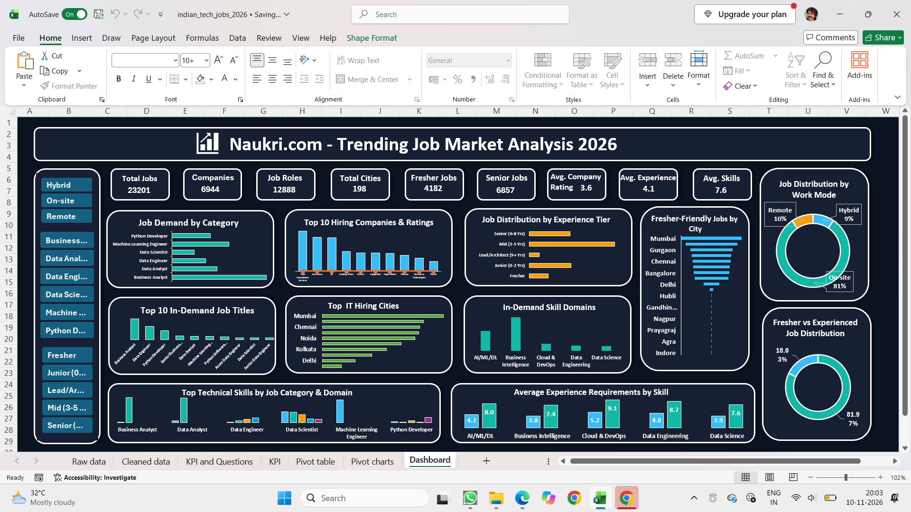

Interactive Dashboard
KPI Cards
Nine headline figures across the top
Chart Panels
Roles, companies, cities, skills and experience
Slicers
Work mode, role category and experience tier

Slide 12



Who Benefits from This Project?
Job Seekers
Freshers
Identify in-demand roles, hiring cities and common skills
Spot fresher opportunities and skills to build first
Recruiters
HR Teams
Explore hiring activity, role categories and locations
Compare work-mode and experience patterns in the market
Training Institutes
Career Guidance Teams
Align training topics with skill domains in listings
Guide learners toward relevant skills and job categories

Slide 13
Conclusion & Future Scope
Conclusion
This project shows an end-to-end Excel analytics workflow: clean job-listing data in Power Query, organize it into a structured dataset, summarize it with PivotTables and communicate patterns through an interactive dashboard that compares roles, companies, locations, experience, skills and work modes.
Thank you

